Slide 1
Reporting Aggregated Data Using the Group Functions
5

Slide 2
Objectives
After completing this lesson, you should be able to do the following:
Identify the available group functions
Describe the use of group functions
Group data by using the GROUP BY clause
Include or exclude grouped rows by using the HAVING
clause

Slide 3
Lesson Agenda
Group functions:
Types and syntax
Use AVG, SUM, MIN, MAX, COUNT
Use the DISTINCT keyword within group functions
NULL values in a group function
Grouping rows:
GROUP BY clause
HAVING clause
Nesting group functions

Slide 4
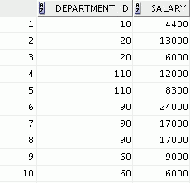


What Are Group Functions?
Group functions operate on sets of rows to give one result per group.
EMPLOYEES
Maximum salary in
EMPLOYEES table
…

Slide 5
Types of Group Functions
AVG
COUNT
MAX
MIN
SUM
Group functions

Slide 6
Group Functions: Syntax
SELECT |  | group_function(column), ...
FROM [WHERE [ORDER | BY | table condition] column];

Slide 7
Using the AVG and SUM Functions
You can use AVG and SUM for numeric data.
SELECT
AVG(salary), MAX(salary),
MIN(salary), SUM(salary)
FROM WHERE
employees
job_id LIKE '%REP%';

Slide 8

Using the MIN and MAX Functions
You can use MIN and MAX for numeric, character, and date data types.
SELECT FROM
MIN(hire_date), MAX(hire_date)
employees;

Slide 9


Using the COUNT Function
COUNT(*) returns the number of rows in a table:
SELECT
FROM employees
WHERE department_id = 50;
COUNT(*)
1
COUNT(expr) returns the number of rows with non-null values for expr:
SELECT
FROM employees
WHERE department_id = 80;
COUNT(commission_pct)
2

Slide 10

Using the DISTINCT Keyword
COUNT(DISTINCT expr) returns the number of distinct non-null values of expr.
To display the number of distinct department values in the
EMPLOYEES table:
SELECT
FROM employees;
COUNT(DISTINCT department_id)

Slide 11


Group Functions and Null Values
Group functions ignore null values in the column:
SELECT
FROM employees;
1
AVG(commission_pct)
The NVL function forces group functions to include null values:
SELECT AVG(NVL(commission_pct, 0)) FROM employees;
2

Slide 12
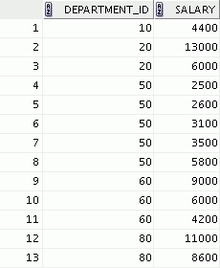
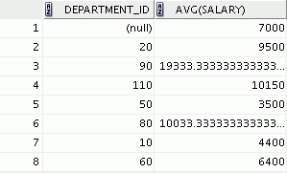

Creating Groups of Data
EMPLOYEES
Average salary in the EMPLOYEES table for each department
4400
9500
3500
6400
10033
…

Slide 13
Creating Groups of Data: GROUP BY Clause Syntax
SELECT FROM [WHERE
column, group_function(column) table
condition]
[GROUP BY group_by_expression]
[ORDER BY column];

Slide 14
Using the GROUP BY Clause
All the columns in the SELECT list that are not in group functions must be in the GROUP BY clause.
SELECT AVG(salary)
FROM
department_id,
employees
GROUP BY department_id ;

Slide 15
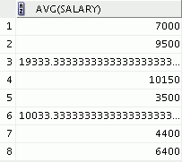
Using the GROUP BY Clause
The GROUP BY column does not have to be in the SELECT list.
SELECT AVG(salary) FROM employees
 | GROUP BY department_id | ;

Slide 16
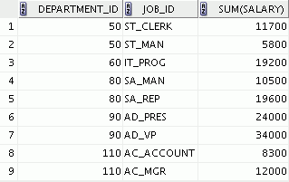
Using the GROUP BY Clause on Multiple Columns
SELECT FROM WHERE
department_id, job_id, SUM(salary) employees
department_id > 40
GROUP BY department_id, job_id
ORDER BY department_id;

Slide 17


Illegal Queries Using Group Functions
Any column or expression in the SELECT list that is not an aggregate function must be in the GROUP BY clause:
SELECT department_id, COUNT(last_name) FROM employees;
A GROUP BY clause must be added to count the last names for each department_id.
SELECT department_id, job_id, COUNT(last_name) FROM employees
GROUP BY department_id;
Either add job_id in the GROUP BY or remove the job_id column from the SELECT list.

Slide 18
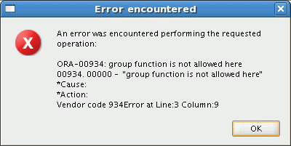
Illegal Queries Using Group Functions
You cannot use the WHERE clause to restrict groups.
You use the HAVING clause to restrict groups.
You cannot use group functions in the WHERE clause.
SELECT FROM WHERE
department_id, AVG(salary) employees
AVG(salary) > 8000
GROUP BY department_id;
Cannot use the WHERE clause to restrict groups

Slide 19
Restricting Group Results with the HAVING Clause
When you use the HAVING clause, the Oracle server restricts groups as follows:
Rows are grouped.
The group function is applied.
Groups matching the HAVING clause are displayed.
SELECT FROM [WHERE
column, group_function table
condition]
[GROUP BY group_by_expression] [HAVING group_condition] [ORDER BY column];

Slide 20
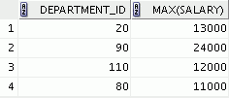
Using the HAVING Clause
SELECT FROM
department_id, MAX(salary) employees
GROUP BY department_id HAVING MAX(salary)>10000 ;

Slide 21

Using the HAVING Clause
SELECT FROM WHERE
job_id, SUM(salary) PAYROLL employees
job_id NOT LIKE '%REP%'
GROUP BY job_id
HAVING SUM(salary) > 13000
ORDER BY SUM(salary);

Slide 22
Summary
In this lesson, you should have learned how to:
Use the group functions COUNT, MAX, MIN, SUM, and AVG
Write queries that use the GROUP BY clause
Write queries that use the HAVING clause
SELECT FROM [WHERE
column, group_function table
condition]
[GROUP BY group_by_expression] [HAVING group_condition] [ORDER BY column];

Slide 23
Practice 5: Overview
This practice covers the following topics:
Writing queries that use the group functions
Grouping by rows to achieve more than one result
Restricting groups by using the HAVING clause

